Slide 1
Cloud Computing

Slide 2
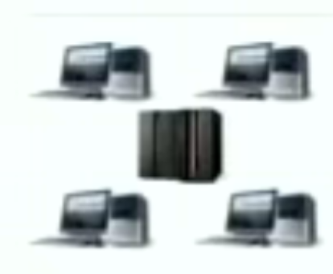
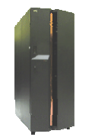
Evolution of Computing with Network (1/2)
Network Computing
  Network is computer (client - server)
  Separation of Functionalities
Cluster Computing
  Tightly coupled computing resources:
  CPU, storage, data, etc. Usually connected within a LAN
  Managed as a single resource
  Commodity, Open source

Slide 3
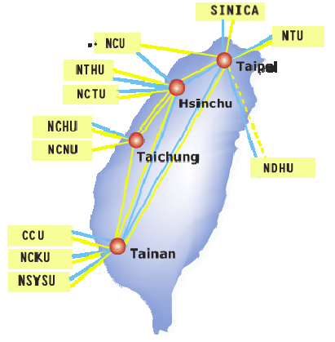
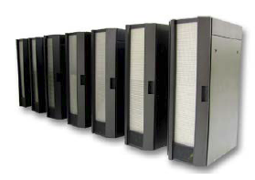
Evolution of Computing with Network (2/2)
Grid Computing
  Resource sharing across several domains
  Decentralized, open standards
  Global resource sharing
Utility Computing
  Don’t buy computers, lease computing power
  Upload, run, download
  Ownership model

Slide 4
The Next Step: Cloud Computing
Service and data are in the cloud, accessible with any device connected to the cloud with a browser
A key technical issue for developer:
  Scalability
Services are not known geographically

Slide 5
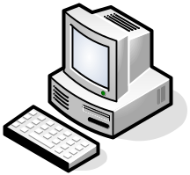

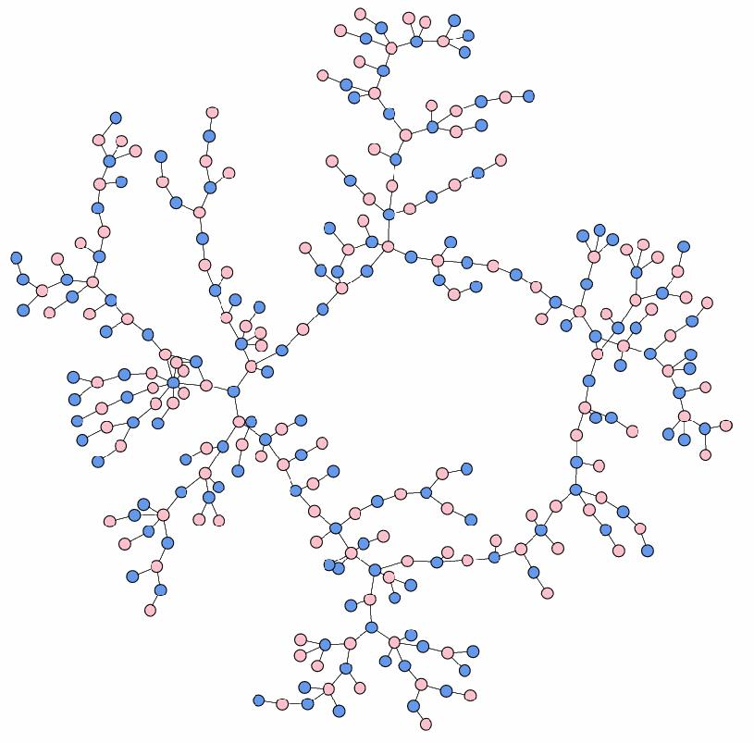

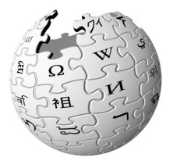

Applications on the Web

Slide 6
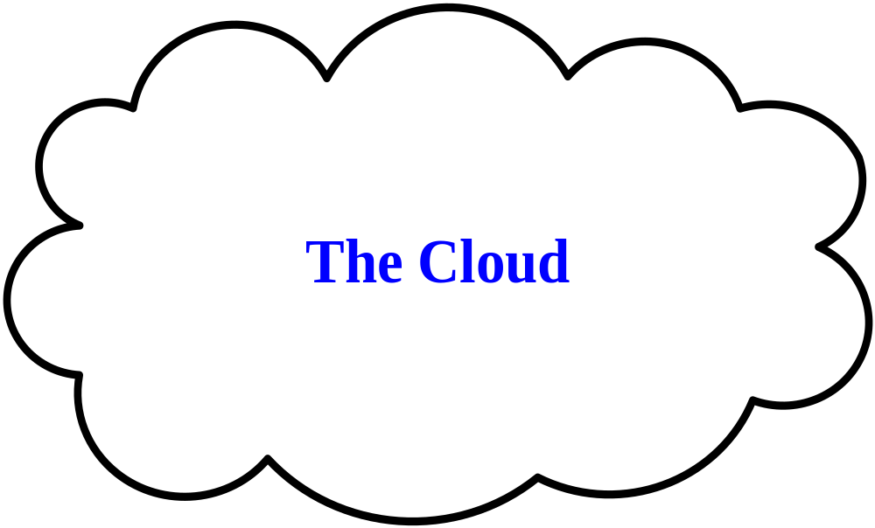
Applications on the Web

Slide 7
Cloud Computing
Definition
  Cloud computing is a concept of using the internet to allow people to access technology-enabled services.
  It allows users to consume services without knowledge of control over the technology infrastructure that supports them.
  - Wikipedia

Slide 8
Major Types of Cloud
Compute and Data Cloud
  Amazon Elastic Computing Cloud (EC2), Google MapReduce, Science clouds
  Provide platform for running science code
Host Cloud
  Google AppEngine
  Highly-available, fault tolerance, robustness for web capability
Services are not known geographically

Slide 9
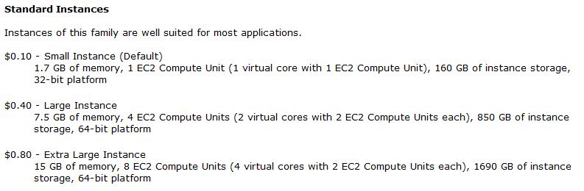
Cloud Computing Example - Amazon EC2
http://aws.amazon.com/ec2

Slide 10
Cloud Computing Example - Google AppEngine
Google AppEngine API
  Python runtime environment
  Datastore API
  Images API
  Mail API
  Memcache API
  URL Fetch API
  Users API
A free account can use up to 500 MB storage, enough CPU and bandwidth for about 5 million page views a month
http://code.google.com/appengine/

Slide 11
Cloud Computing
Advantages
  Separation of infrastructure maintenance duties from application development
  Separation of application code from physical resources
  Ability to use external assets to handle peak loads
  Ability to scale to meet user demands quickly
  Sharing capability among a large pool of users, improving overall utilization
Services are not known geographically

Slide 12
Cloud Computing Summary
Cloud computing is a kind of network service and is a trend for future computing
Scalability matters in cloud computing technology
Users focus on application development
Services are not known geographically

Slide 13
Counting the numbers vs. Programming model
Personal Computer
  One to One
Client/Server
  One to Many
Cloud Computing
  Many to Many

Slide 14
What Powers Cloud Computing in Google?
Commodity Hardware
  Performance: single machine not interesting
  Reliability
    Most reliable hardware will still fail: fault-tolerant software needed
    Fault-tolerant software enables use of commodity components
  Standardization: use standardized machines to run all kinds of applications

Slide 15
What Powers Cloud Computing in Google?
Infrastructure Software
  Distributed storage:
    Distributed File System (GFS)
  Distributed semi-structured data system
    BigTable
  Distributed data processing system
    MapReduce
What is the common issues of all these software?

Slide 16
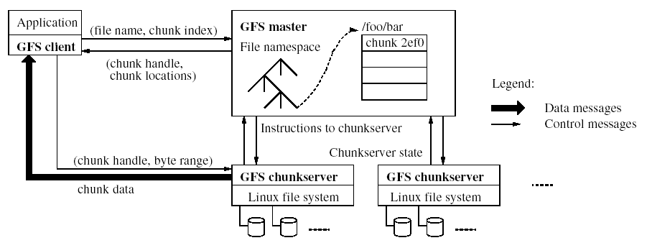
Google File System
Files broken into chunks (typically 4 MB)
Chunks replicated across three machines for safety (tunable)
Data transfers happen directly between clients and chunkservers

Slide 17
GFS Usage @ Google
200+ clusters
Filesystem clusters of up to 5000+ machines
Pools of 10000+ clients
5+ Petabyte Filesystems
All in the presence of frequent HW failure

Slide 18
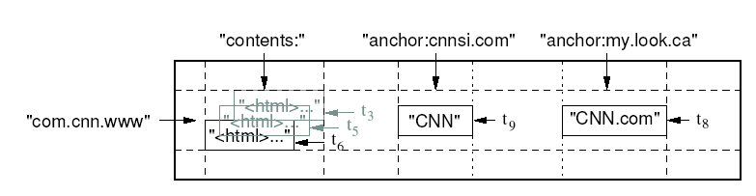
BigTable
Data model
  (row, column, timestamp) → cell contents

Slide 19
BigTable
Distributed multi-level sparse map
  Fault-tolerance, persistent
Scalable
  Thousand of servers
  Terabytes of in-memory data
  Petabytes of disk-based data
Self-managing
  Servers can be added/removed dynamically
  Servers adjust to load imbalance

Slide 20
Why not just use commercial DB?
Scale is too large or cost is too high for most commercial databases
Low-level storage optimizations help performance significantly
  Much harder to do when running on top of a database layer
  Also fun and challenging to build large-scale systems

Slide 21
BigTable Summary
Data model applicable to broad range of clients
  Actively deployed in many of Google’s services
System provides high-performance storage system on a large scale
  Self-managing
  Thousands of servers
  Millions of ops/second
  Multiple GB/s reading/writing
Currently – 500+ BigTable cells
Largest bigtable cell manages – 3PB of data spread over several thousand machines

Slide 22
Distributed Data Processing
Problem: How to count words in the text files?
  Input files: N text files
  Size: multiple physical disks
  Processing phase 1: launch M processes
    Input: N/M text files
    Output: partial results of each word’s count
  Processing phase 2: merge M output files of step 1

Slide 23
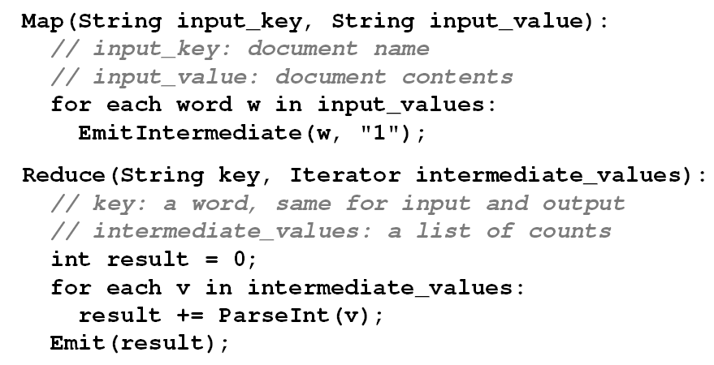
Pseudo Code of WordCount

Slide 24
Task Management
Logistics
  Decide which computers to run phase 1, make sure the files are accessible (NFS-like or copy)
  Similar for phase 2
Execution:
  Launch the phase 1 programs with appropriate command line flags, re-launch failed tasks until phase 1 is done
  Similar for phase 2
Automation: build task scripts on top of existing batch system

Slide 25
Technical issues
File management: where to store files?
  Store all files on the same file server → Bottleneck
  Distributed file system: opportunity to run locally
Granularity: how to decide N and M?
Job allocation: assign which task to which node?
  Prefer local job: knowledge of file system
Fault-recovery: what if a node crashes?
  Redundancy of data
  Crash-detection and job re-allocation necessary

Slide 26
MapReduce
A simple programming model that applies to many data-intensive computing problems
Hide messy details in MapReduce runtime library
  Automatic parallelization
  Load balancing
  Network and disk transfer optimization
  Handle of machine failures
  Robustness
  Easy to use

Slide 27
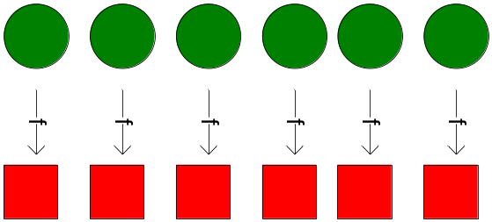
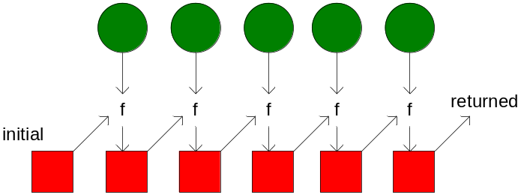
MapReduce Programming Model
Borrowed from functional programming
map(f, [x₁,…,x_{m},…]) = [f(x₁),…,f(x_{m}),…]
reduce(f, x₁, [x₂, x₃,…])
  = reduce(f, f(x₁, x₂), [x₃,…])
  = …
  (continue until the list is exhausted)
Users implement two functions
map (in_key, in_value) → (key, value) list
reduce (key, [value₁,…,value_{m}]) → f_value

Slide 28
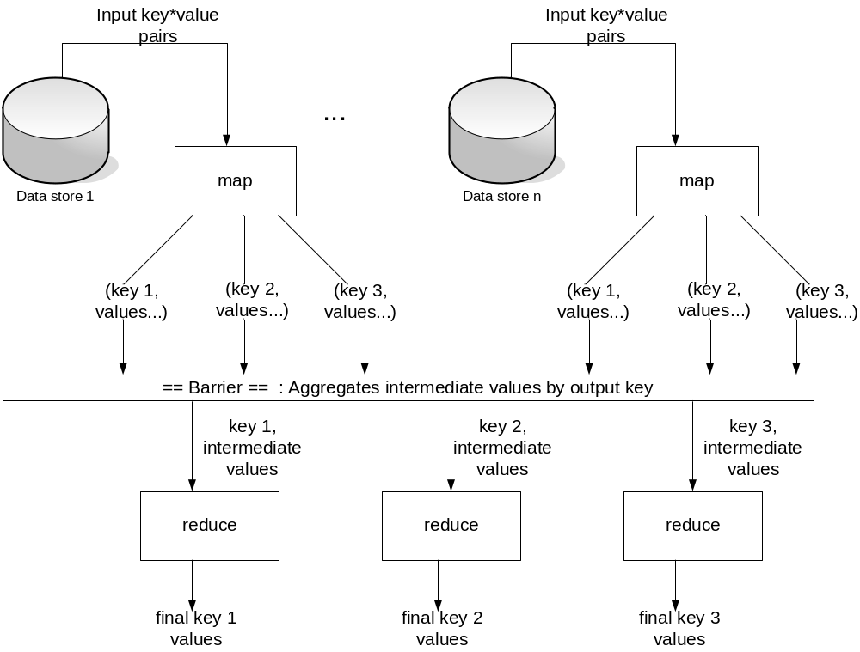
MapReduce – A New Model and System
Two phases of data processing
  Map: (in_key, in_value) → {(key_{j}, value_{j}) | j = 1…k}
  Reduce: (key, [value₁,…value_{m}]) → (key, f_value)

Slide 29
MapReduce Version of Pseudo Code
No File I/O
Only data processing logic

Slide 30
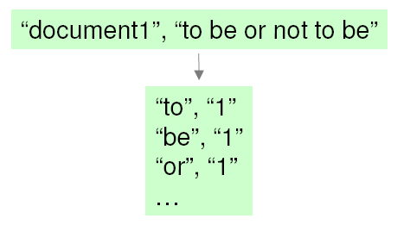
Example – WordCount (1/2)
Input is files with one document per record
Specify a map function that takes a key/value pair
  key = document URL
  Value = document contents
Output of map function is key/value pairs. In our case, output (w,”1”) once per word in the document

Slide 31
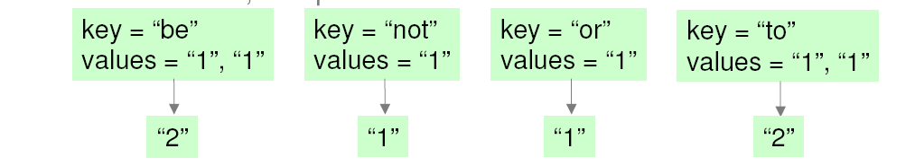
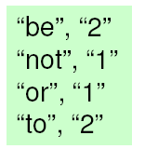
Example – WordCount (2/2)
MapReduce library gathers together all pairs with the same key(shuffle/sort)
The reduce function combines the values for a key. In our case, compute the sum
Output of reduce paired with key and saved

Slide 32
MapReduce Framework
For certain classes of problems, the MapReduce framework provides:
  Automatic & efficient parallelization/distribution
  I/O scheduling: Run mapper close to input data
  Fault-tolerance: restart failed mapper or reducer tasks on the same or different nodes
  Robustness: tolerate even massive failures:
  e.g. large-scale network maintenance: once lost 1800 out of 2000 machines
  Status/monitoring

Slide 33
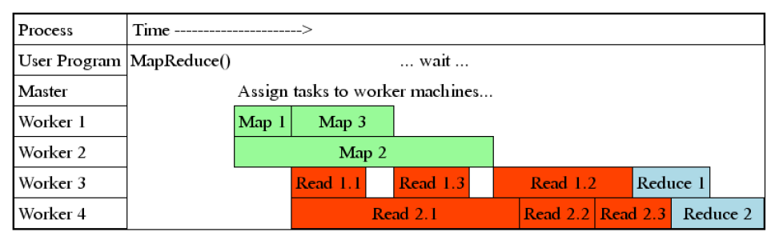
Task Granularity And Pipelining
Fine granularity tasks: many more map tasks than machines
  Minimizes time for fault recovery
  Can pipeline shuffling with map execution
  Better dynamic load balancing
Often use 200,000 map/5000 reduce tasks with 2000 machines

Slide 34
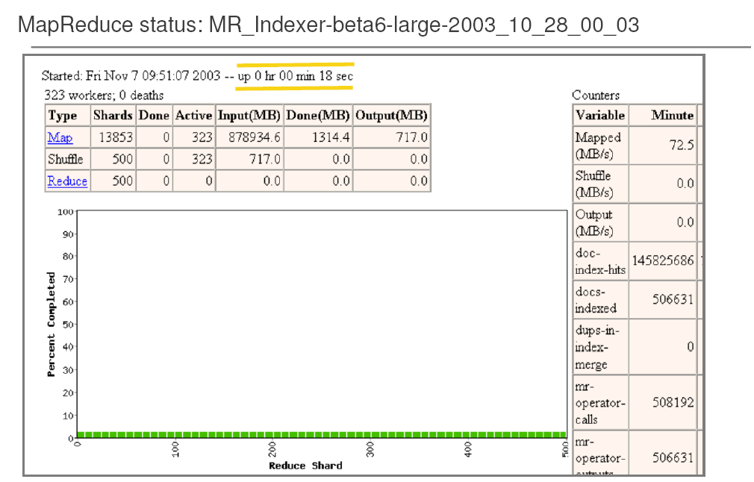

Slide 35
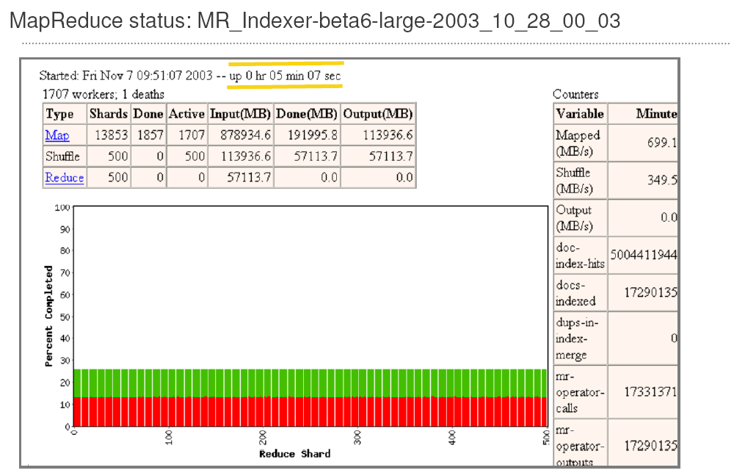

Slide 36
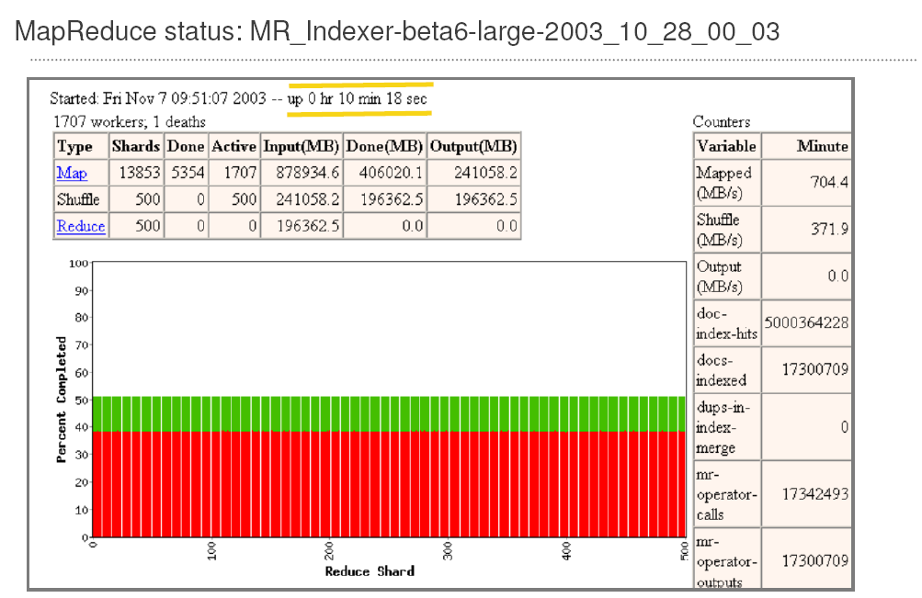

Slide 37
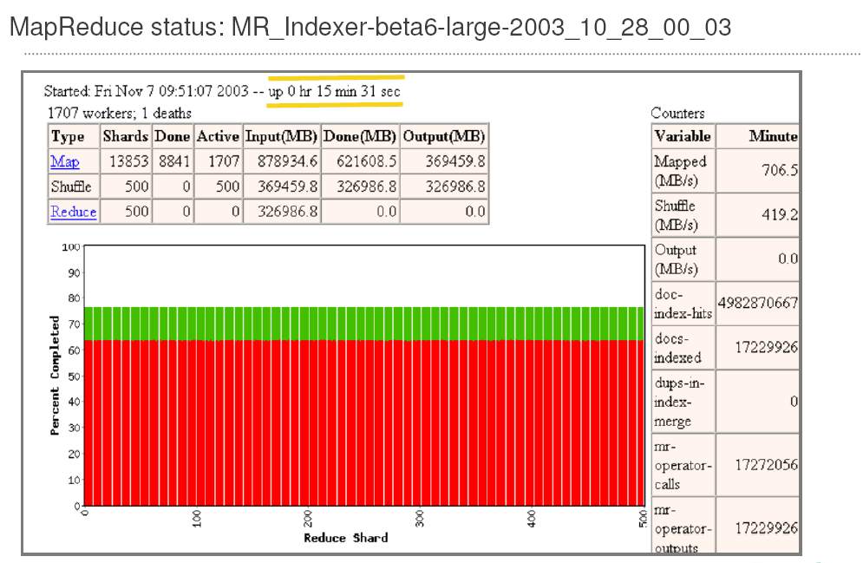

Slide 38
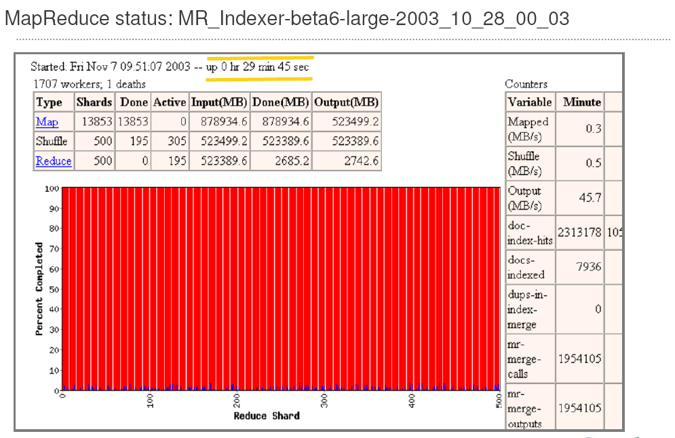

Slide 39
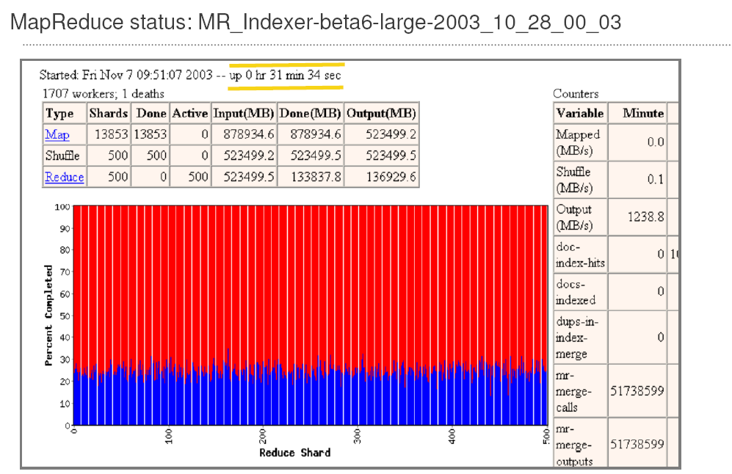

Slide 40
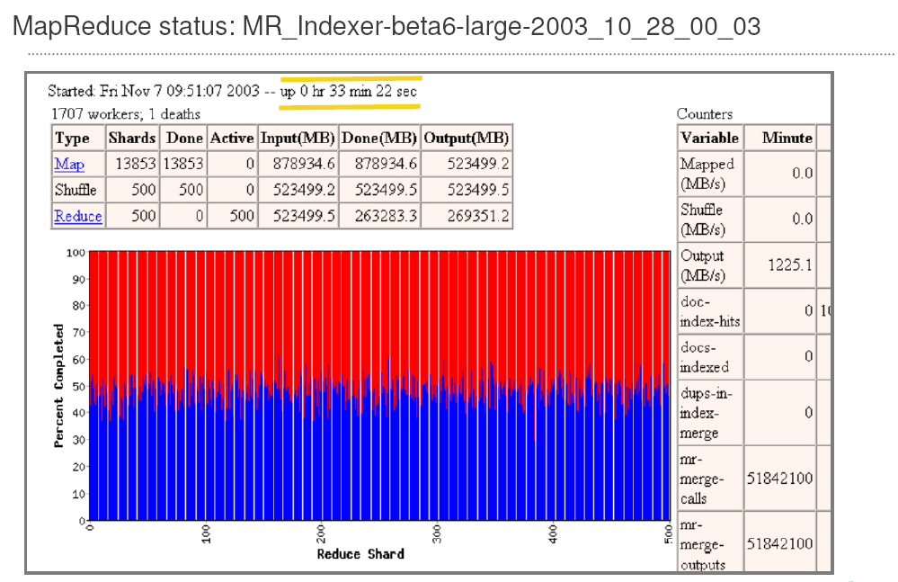

Slide 41
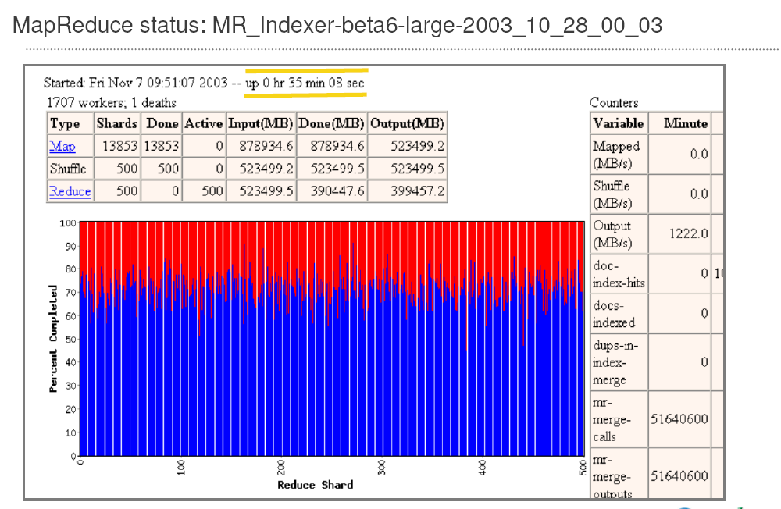

Slide 42
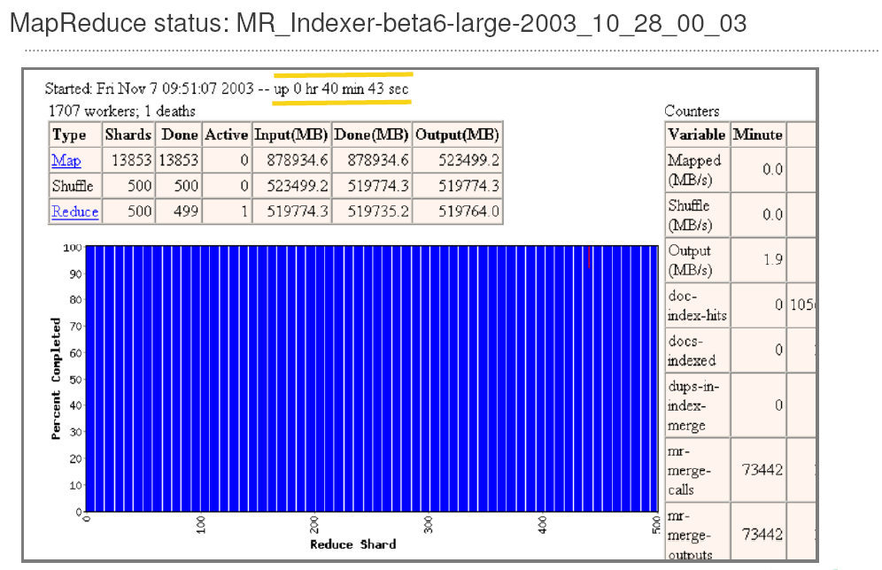

Slide 43
MapReduce: Uses at Google
Typical configuration: 200,000 mappers, 500 reducers on 2,000 nodes
Broad applicability has been a pleasant surprise
  Quality experiences, log analysis, machine translation, ad-hoc data processing
  Production indexing system: rewritten with MapReduce
    ~10 MapReductions, much simpler than old code

Slide 44
MapReduce Summary
MapReduce is proven to be useful abstraction
Greatly simplifies large-scale computation at Google
Fun to use: focus on problem, let library deal with messy details

Slide 45
A Data Playground
MapReduce + BigTable + GFS = Data playground
  Substantial fraction of internet available for processing
  Easy-to-use teraflops/petabytes, quick turn-around
  Cool problems, great colleagues

Slide 46
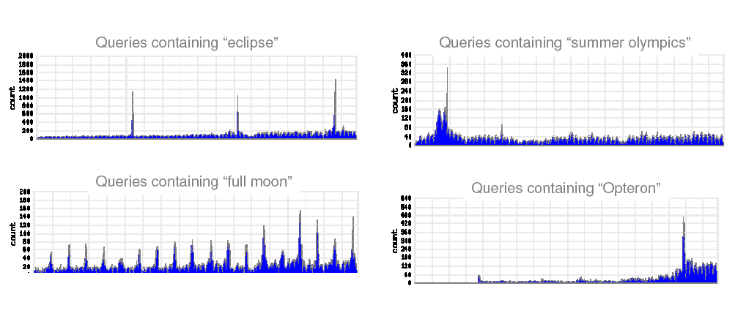

Slide 47
Open Source Cloud Software: Project Hadoop
Google published papers on GFS(‘03), MapReduce(‘04) and BigTable(‘06)
Project Hadoop
  An open source project with the Apache Software Fountation
  Implement Google’s Cloud technologies in Java
  HDFS(GFS) and Hadoop MapReduce are available. Hbase(BigTable) is being developed
Google is not directly involved in the development avoid conflict of interest

Slide 48
Industrial Interest in Hadoop
Yahoo! hired core Hadoop developers
  Announced that their Webmap is produced on a Hadoop cluster with 2000 hosts(dual/quad cores) on Feb. 19, 2008.
Amazon EC2 (Elastic Compute Cloud) supports Hadoop
  Write your mapper and reducer, upload your data and program, run and pay by resource utilization
  Tiff-to-PDF conversion of 11 million scanned New York Times articles (1851-1922) done in 24 hours on Amazon S3/EC2 with Hadoop on 100 EC2 machines
  Many silicon valley startups are using EC2 and starting to use Hadoop for their coolest ideas on internet-scale of data
IBM announced “Blue Cloud,” will include Hadoop among other software components

Slide 49
AppEngine
Run your application on Google infrastructure and data centers
  Focus on your application, forget about machines, operating systems, web server software, database setup/maintenance, load balance, etc.
Operand for public sign-up on 2008/5/28
Python API to Datastore and Users
Free to start, pay as you expand
http://code.google.com/appengine/

Slide 50
Summary
Cloud computing is about scalable web applications and data processing needed to make apps interesting
Lots of commodity PCs: good for scalability and cost
Build web applications to be scalable from the start
  AppEngine allows developers to use Google’s scalable infrastructure and data centers
  Hadoop enables scalable data processing

